Slide 1

Analysis of Large Graphs: Community Detection
Note to other teachers and users of these slides: We would be delighted if you found this our material useful in giving your own lectures. Feel free to use these slides verbatim, or to modify them to fit your own needs. If you make use of a significant portion of these slides in your own lecture, please include this message, or a link to our web site: http://www.mmds.org
Mining of Massive Datasets
Jure Leskovec, Anand Rajaraman, Jeff Ullman Stanford University
http://www.mmds.org

Slide 2
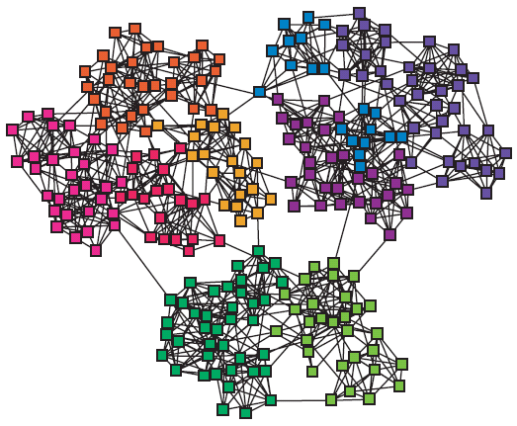
Networks & Communities
We often think of networks being organized into modules, cluster, communities:

Slide 3
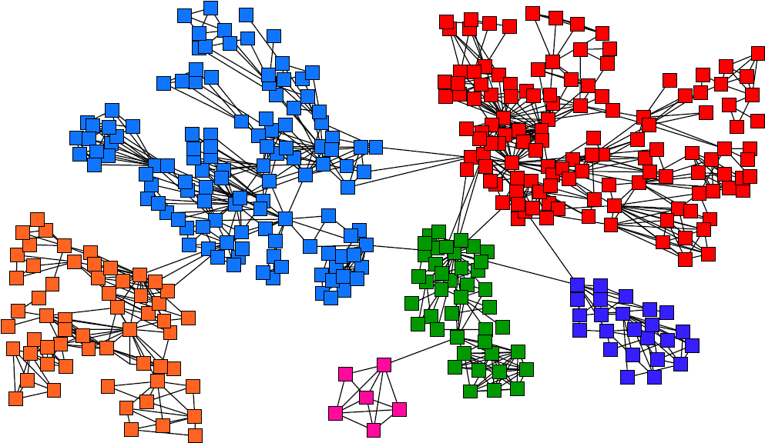
Goal: Find Densely Linked Clusters

Slide 4
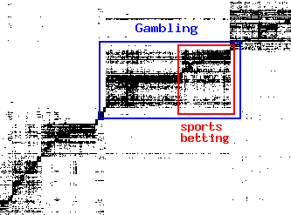
Micro-Markets in Sponsored Search
Find micro-markets by partitioning the query-to-advertiser graph:
query
advertiser
[Andersen, Lang: Communities from seed sets, 2006]

Slide 5
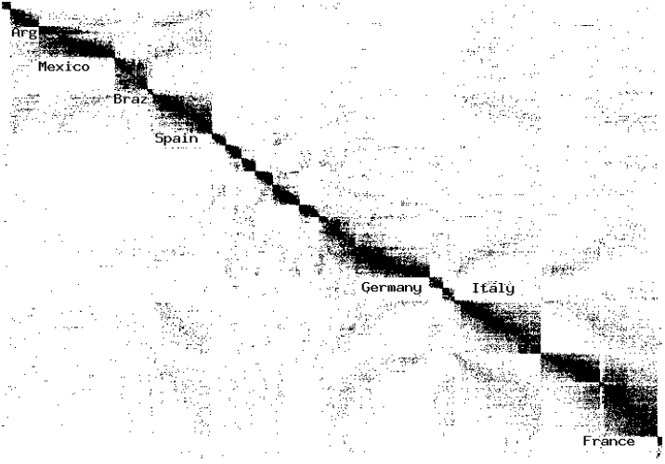
Movies and Actors
Clusters in Movies-to-Actors graph:
[Andersen, Lang: Communities from seed sets, 2006]

Slide 6
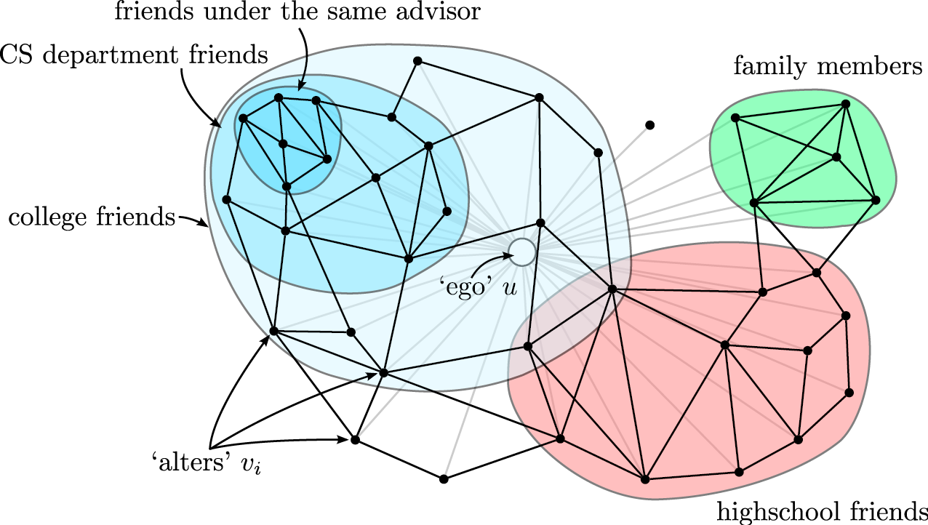
Twitter & Facebook
Discovering social circles, circles of trust:
[McAuley, Leskovec: Discovering social circles in ego networks, 2012]

Slide 7
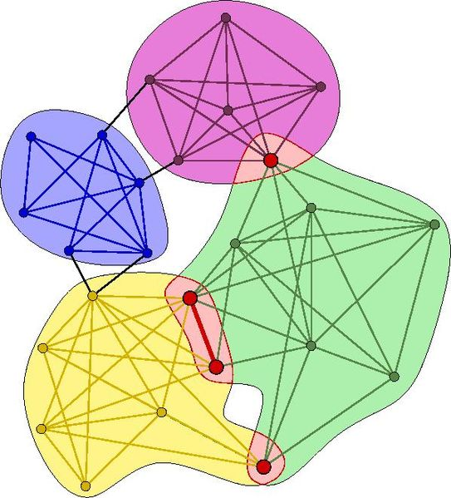
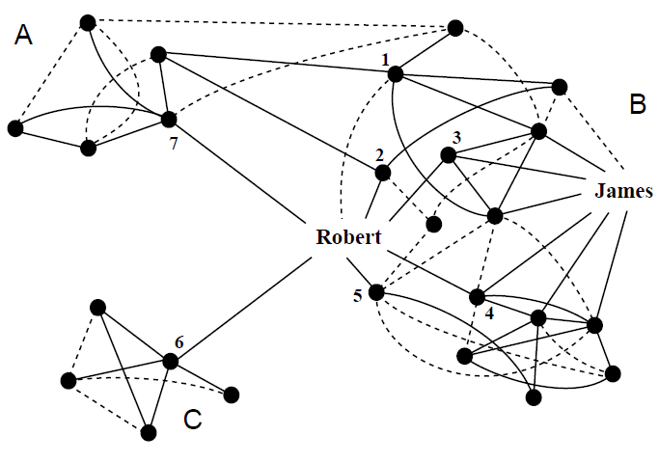
Community Detection
How to find communities?
We will work with undirected (unweighted) networks

Slide 8
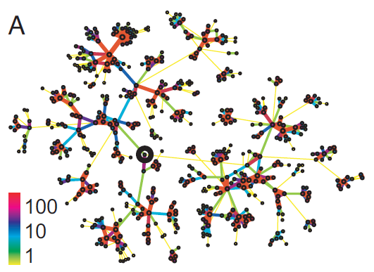
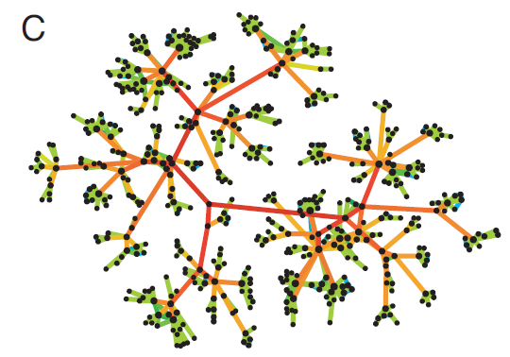
Method 1: Strength of Weak Ties
Edge betweenness: Number of shortest paths passing over the edge
Intuition:
b=16
b=7.5
Edge strengths (call volume) in a real network
Edge betweenness in a real network

Slide 9
Method 1: Girvan-Newman
[Girvan-Newman ‘02]
Divisive hierarchical clustering based on the notion of edge betweenness:
Number of shortest paths passing through the edge
Girvan-Newman Algorithm:
Undirected unweighted networks
Repeat until no edges are left:
Calculate betweenness of edges
Remove edges with highest betweenness
Connected components are communities
Gives a hierarchical decomposition of the network
Like clustering, except that…
we do not use multiple attributes (features) to measure distance/similarity of points, but only rely on their connection structure.

Slide 10
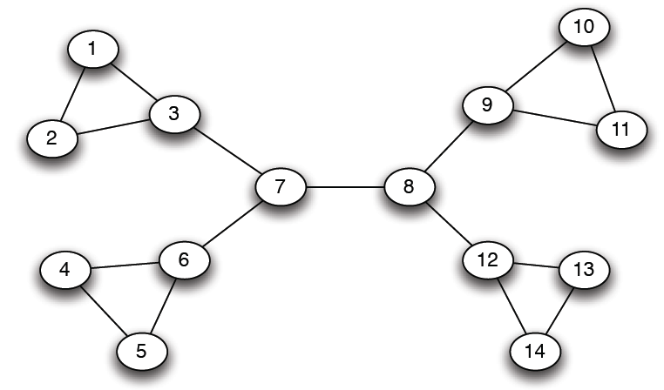
Girvan-Newman: Example
12
1
33
49
Need to re-compute betweenness at every step

Slide 11
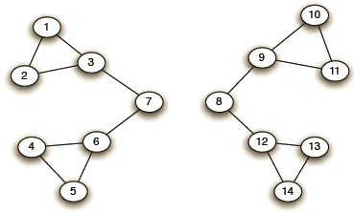
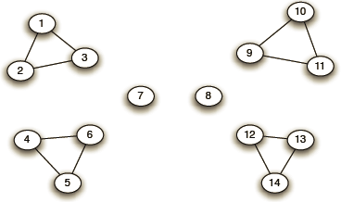
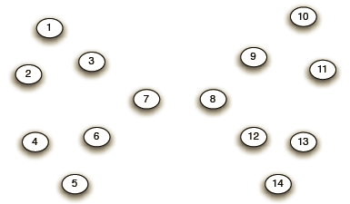
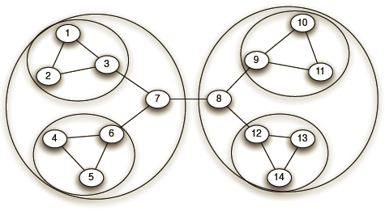
Girvan-Newman: Example
Step 1:
Step 2:
Step 3:
Hierarchical network decomposition:

Slide 12
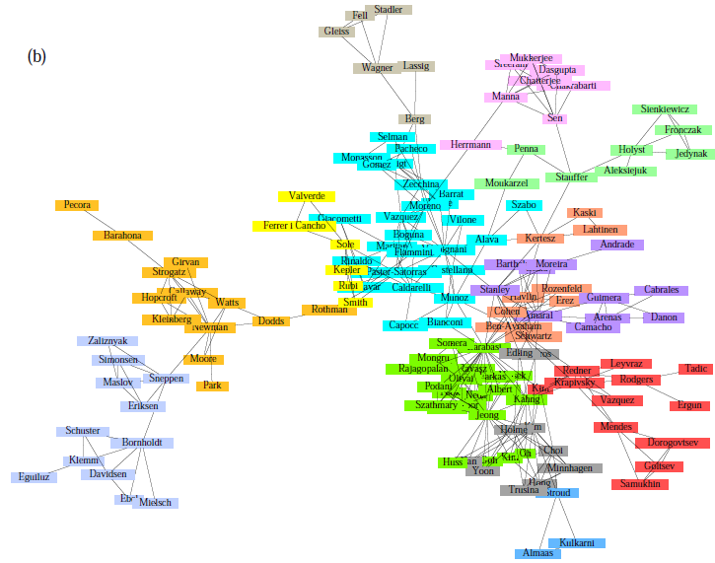
Girvan-Newman: Results
Communities in physics collaborations

Slide 13
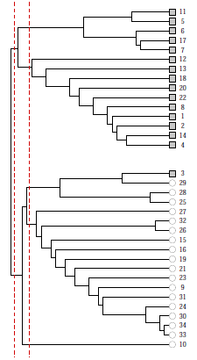
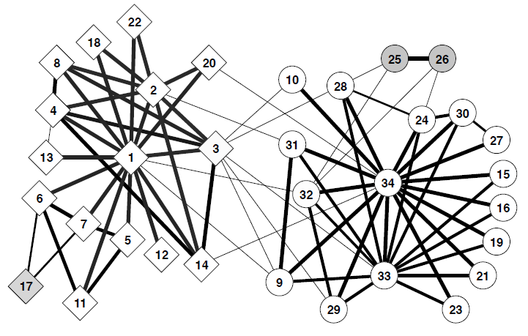
Girvan-Newman: Results
Zachary’s Karate club: Hierarchical decomposition

Slide 14
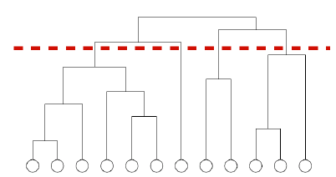
We need to resolve 2 questions
How to compute betweenness?
How to select the number of clusters?

Slide 15
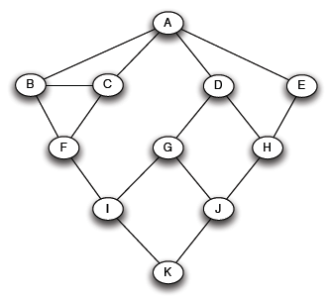
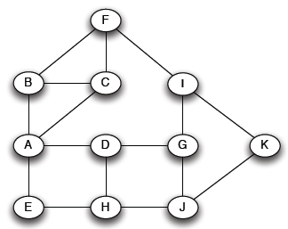

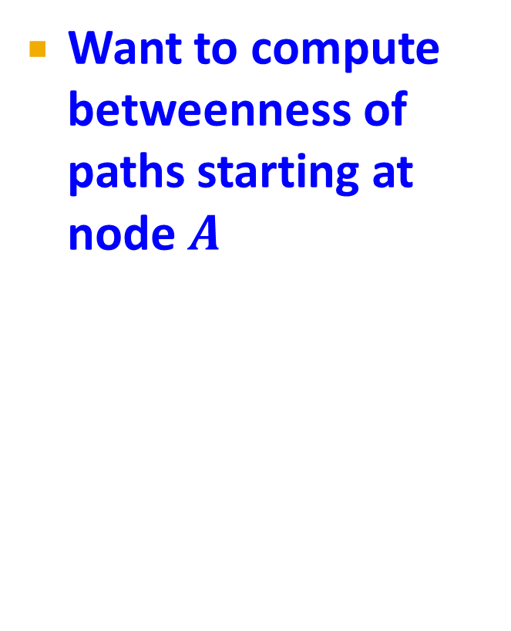
How to Compute Betweenness?
Want to compute betweenness of paths starting at node $A$
Breadth first search starting from $A$:
0
1
2
3
4

Slide 16
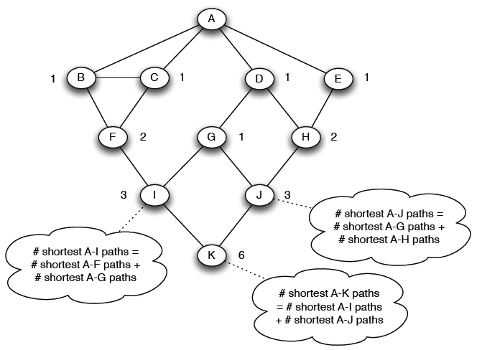
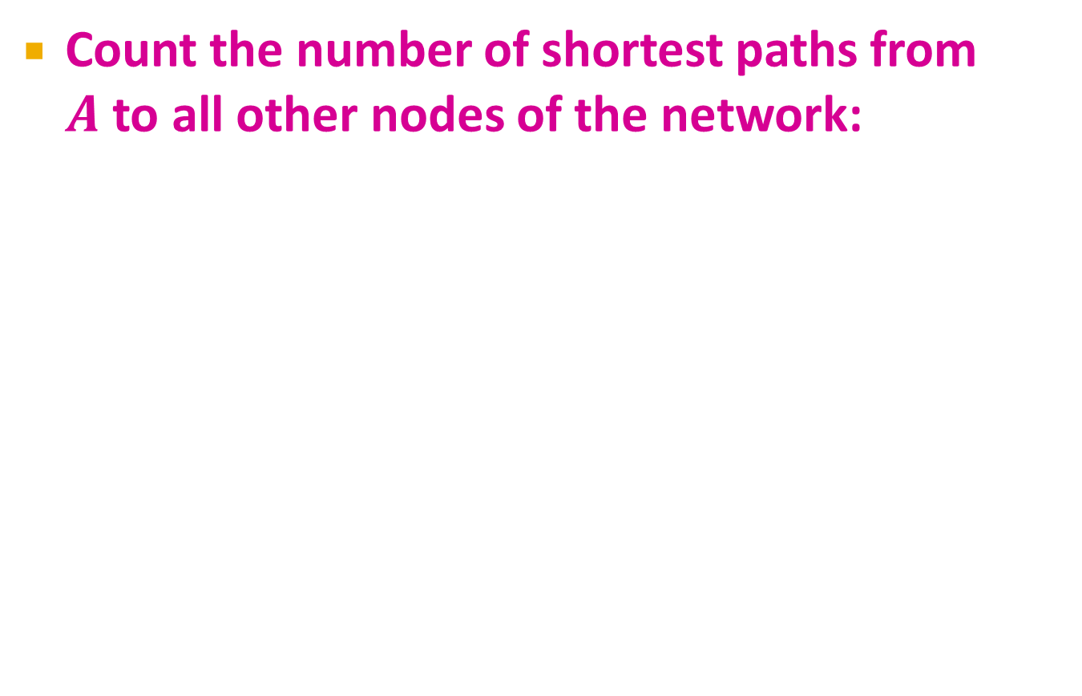
How to Compute Betweenness?
Count the number of shortest paths from $A$ to all other nodes of the network:

Slide 17
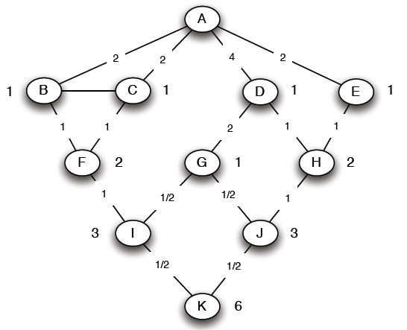
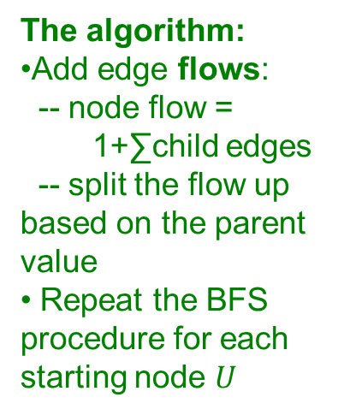
How to Compute Betweenness?
Compute betweenness by working up the tree: If there are multiple paths count them fractionally
The algorithm:
Add edge flows:
-- node flow = 1+∑child edges
-- split the flow up based on the parent value
Repeat the BFS procedure for each starting node $U$
1+1 paths to H
Split evenly
1+0.5 paths to J
Split 1:2
1 path to K.
Split evenly

Slide 18
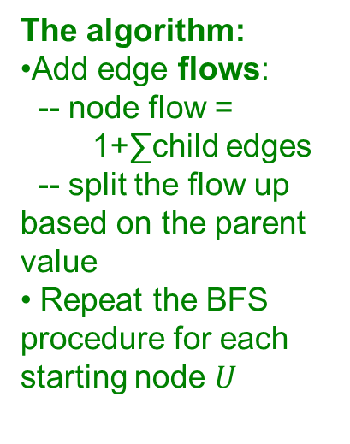
How to Compute Betweenness?
Compute betweenness by working up the tree: If there are multiple paths count them fractionally
The algorithm:
Add edge flows:
-- node flow = 1+∑child edges
-- split the flow up based on the parent value
Repeat the BFS procedure for each starting node $U$
1+1 paths to H
Split evenly
1+0.5 paths to J
Split 1:2
1 path to K.
Split evenly

Slide 19
We need to resolve 2 questions
How to compute betweenness?
How to select the number of clusters?

Slide 20
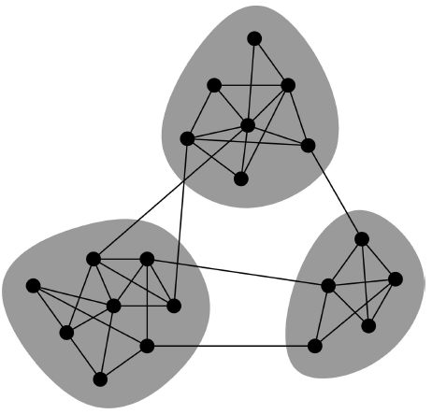
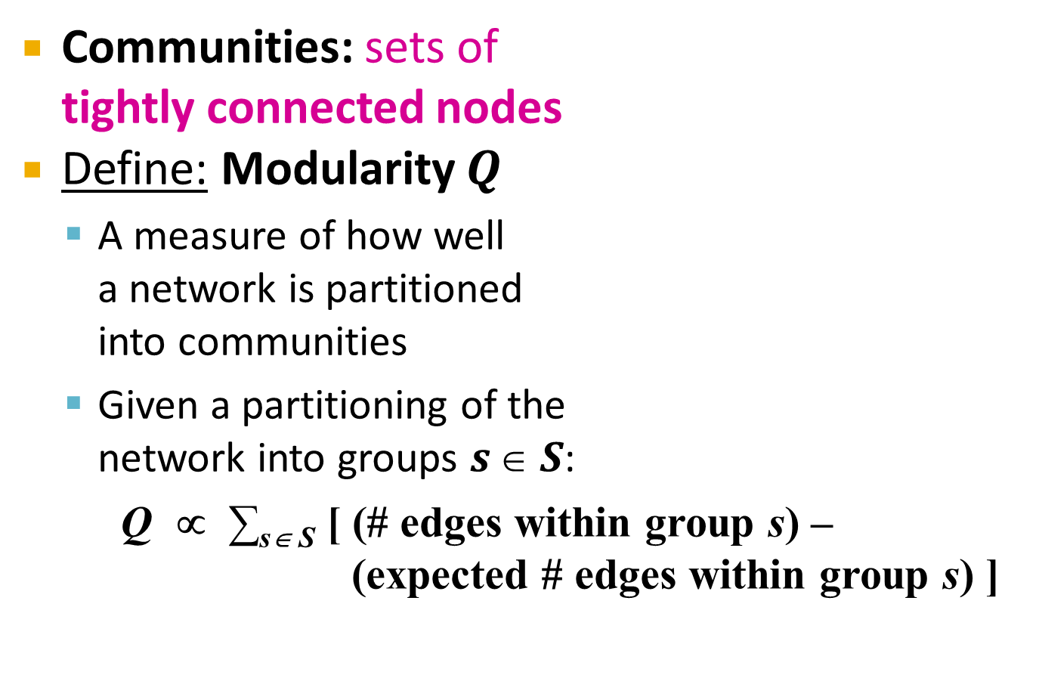
Network Communities
Communities: sets of tightly connected nodes
Define: Modularity $Q$
A measure of how well a network is partitioned into communities
Given a partitioning of the network into groups $s  S$:
Q ∝ ∑_{s∈ S} [ (# edges within group s) – (expected # edges within group s) ]
Need a null model!

Slide 21
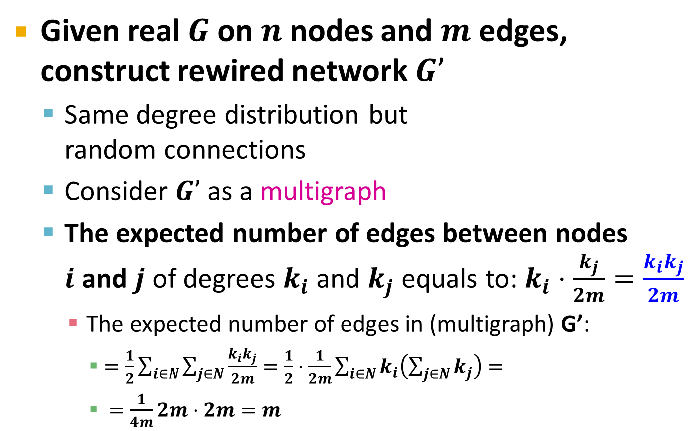
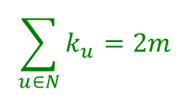
Null Model: Configuration Model
Given real $G$ on $n$ nodes and $m$ edges, construct rewired network $G’$
Same degree distribution but random connections
Consider $G’$ as a multigraph
The expected number of edges between nodes $i$ and $j$ of degrees $k_{i}$and $k_{j}$ equals to: $k_{i}⋅\frac{k_{j}}{2m}=\frac{k_{i}k_{j}}{2m}$
The expected number of edges in (multigraph) G’:
$=\frac{1}{2}\sum_{i∈N}{\sum_{j∈N}{\frac{k_{i}k_{j}}{2m}}}=\frac{1}{2}⋅\frac{1}{2m}\sum_{i∈N}{k_{i}\left(\sum_{j∈N}{k_{j}}\right)}=$
$=\frac{1}{4m}2m⋅2m=m$
i
j
Note:
$$\sum_{u∈N}{k_{u}}=2m$$

Slide 22
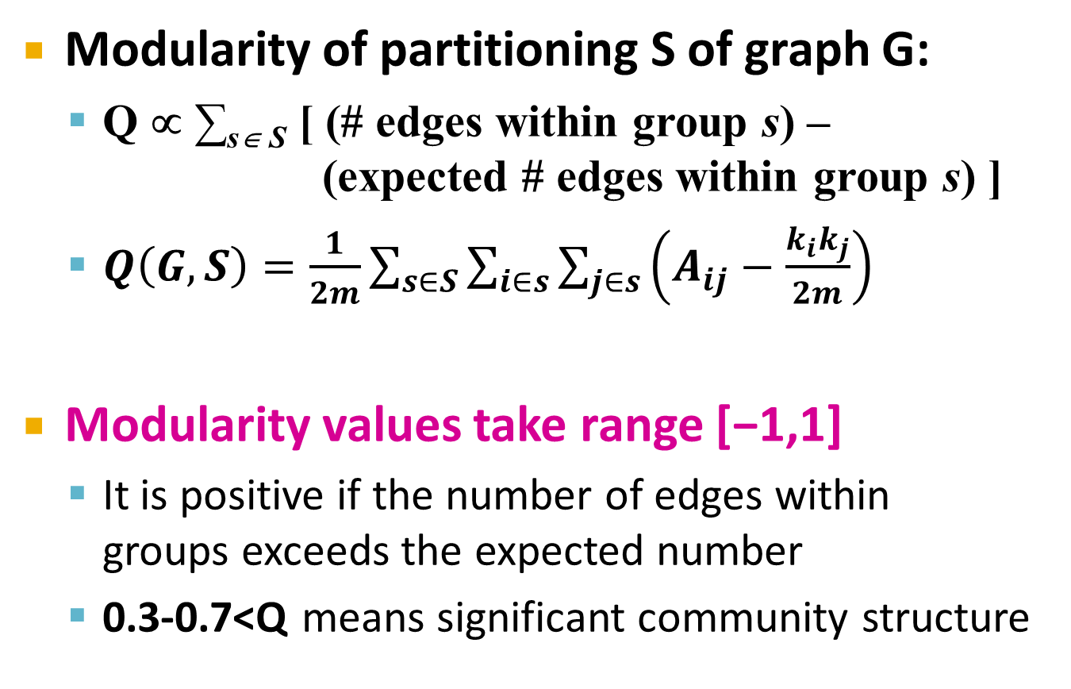
Modularity
Modularity of partitioning S of graph G:
Q ∝ ∑_{s∈ S} [ (# edges within group s) – (expected # edges within group s) ]
$Q\left(G,S\right)=\frac{1}{2m}\sum_{s∈S}{\sum_{i∈s}{\sum_{j∈s}{\left(A_{ij}−\frac{k_{i}k_{j}}{2m}\right)}}}$
Modularity values take range [−1,1]
It is positive if the number of edges within groups exceeds the expected number
0.3-0.7<Q means significant community structure
A_{ij} = 1 if i→j, 0 else
Normalizing cost.: -1<Q<1

Slide 23
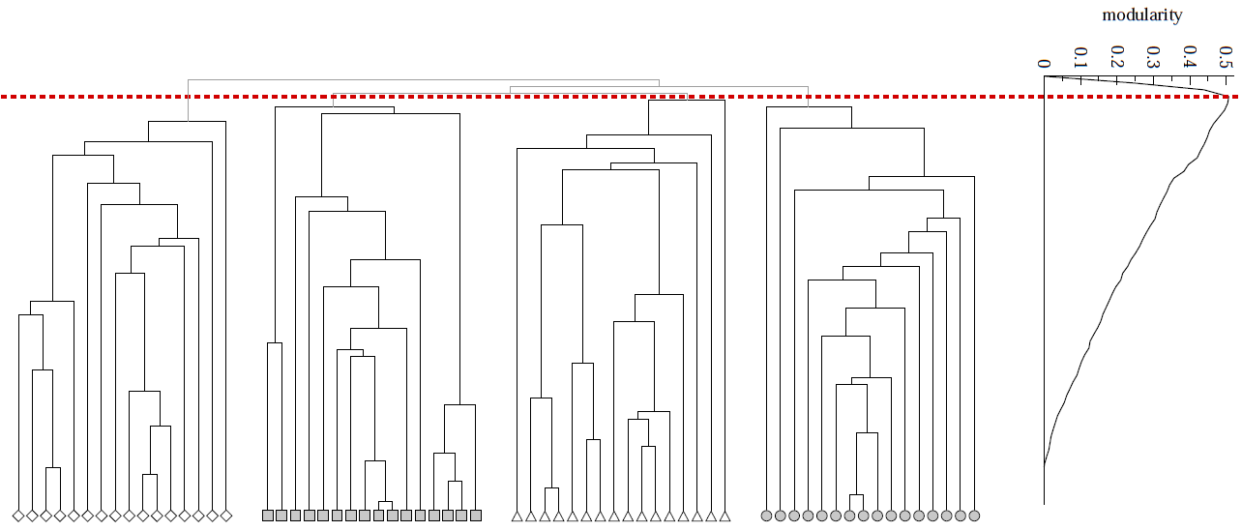
Modularity: Number of clusters
Modularity is useful for selecting the number of clusters:
Q
Next time: Why not optimize Modularity directly?
Notes:
HW: Question – come up with a graph where GIRVAN-NEWMAN MODULARITY IS NOT UNIMODAL

Slide 24
Spectral Clustering

Slide 25
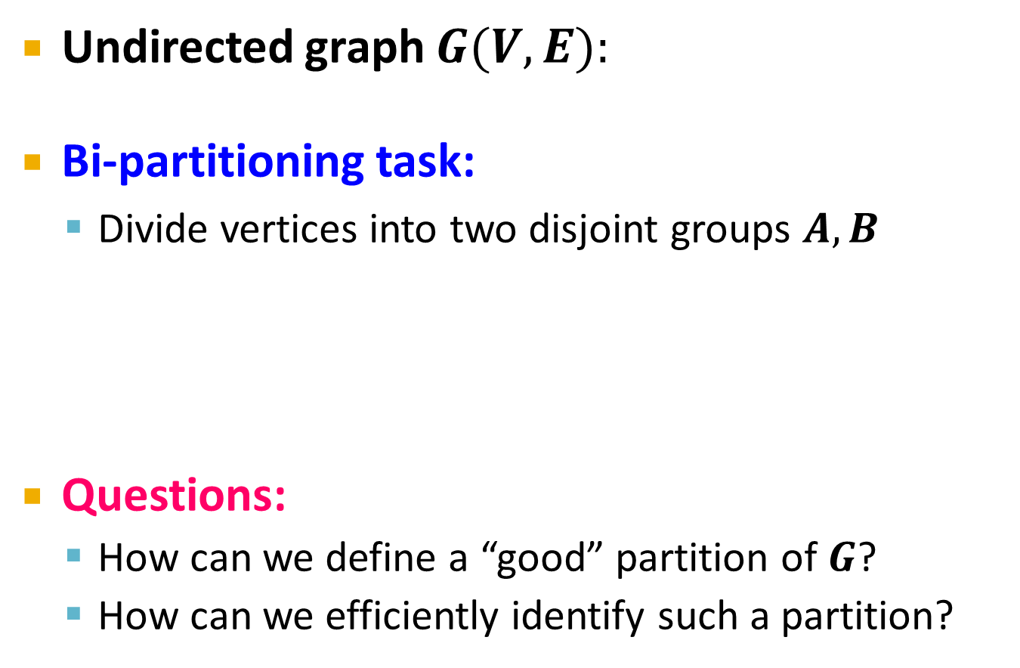
Graph Partitioning
1
5
Undirected graph $G(V,E):$
Bi-partitioning task:
Divide vertices into two disjoint groups $A, B$
Questions:
How can we define a “good” partition of $G$?
How can we efficiently identify such a partition?
2
6
4
3
A
5
B
1
2
6
3
4

Slide 26
Graph Partitioning
What makes a good partition?
Maximize the number of within-group connections
Minimize the number of between-group connections
5
1
2
6
4
3
A
B

Slide 27
Graph Cuts
Express partitioning objectives as a function of the “edge cut” of the partition
Cut: Set of edges with only one vertex in a group:
A
B
5
1
cut(A,B) = 2
2
6
4
3

Slide 28
Graph Cut Criterion
Criterion: Minimum-cut
Minimize weight of connections between groups
Degenerate case:
Problem:
Only considers external cluster connections
Does not consider internal cluster connectivity
arg min_{A,B} cut(A,B)
“Optimal cut”
Minimum cut

Slide 29
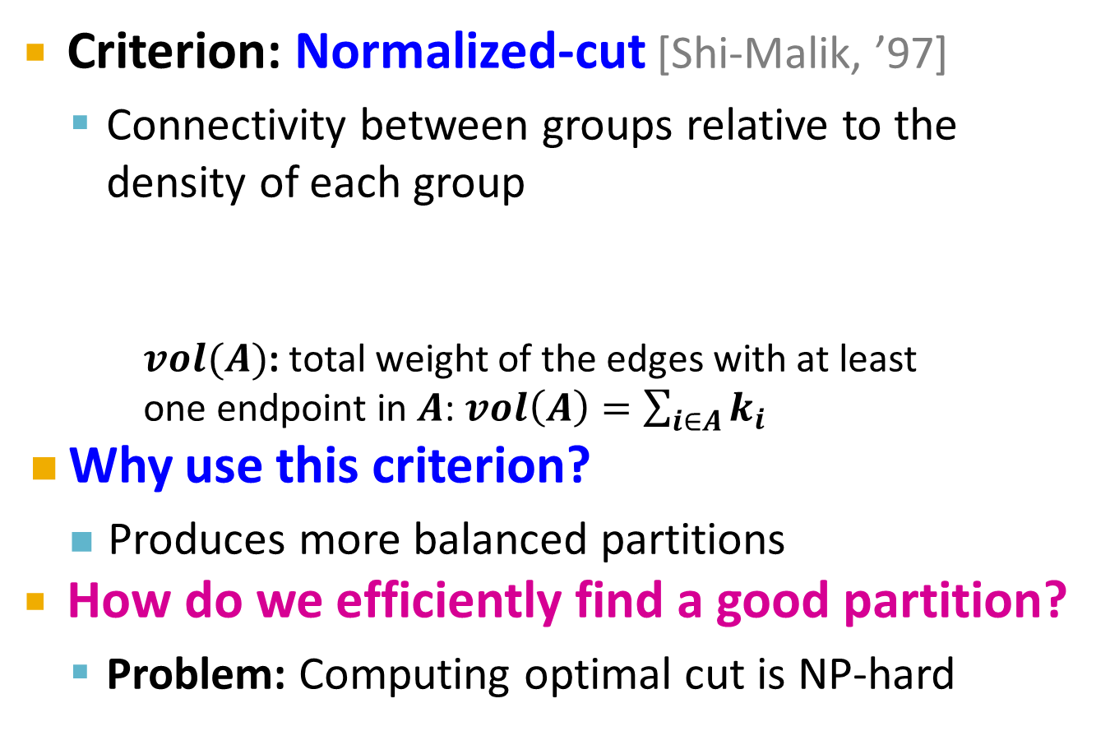
Graph Cut Criteria
[Shi-Malik]
Criterion: Normalized-cut [Shi-Malik, ’97]
Connectivity between groups relative to the density of each group
$vol(A)$: total weight of the edges with at least one endpoint in $A$: $vol\left(A\right)=\sum_{i∈A}{k_{i}}$
Why use this criterion?
Produces more balanced partitions
How do we efficiently find a good partition?
Problem: Computing optimal cut is NP-hard

Slide 30
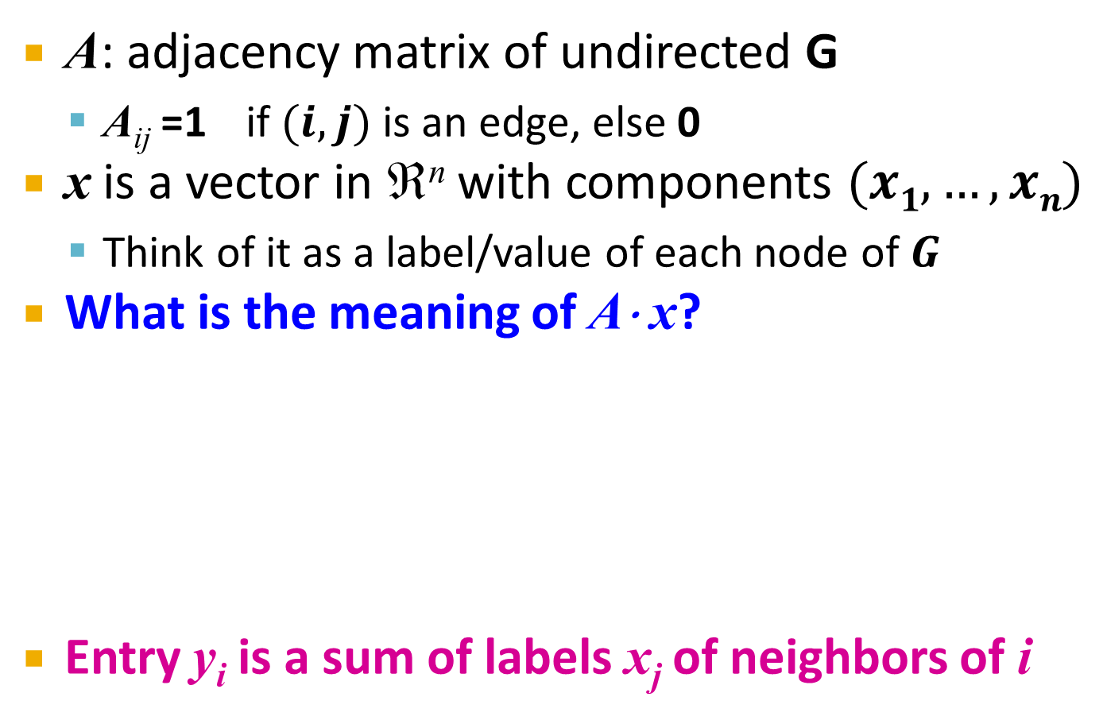
Spectral Graph Partitioning
A: adjacency matrix of undirected G
A_{ij} =1 if $(i,j)$ is an edge, else 0
x is a vector in ℜ^{n} with components $(x1,…, xn)$
Think of it as a label/value of each node of $G$
What is the meaning of A⋅ x?
Entry y_{i} is a sum of labels x_{j} of neighbors of i

Slide 31
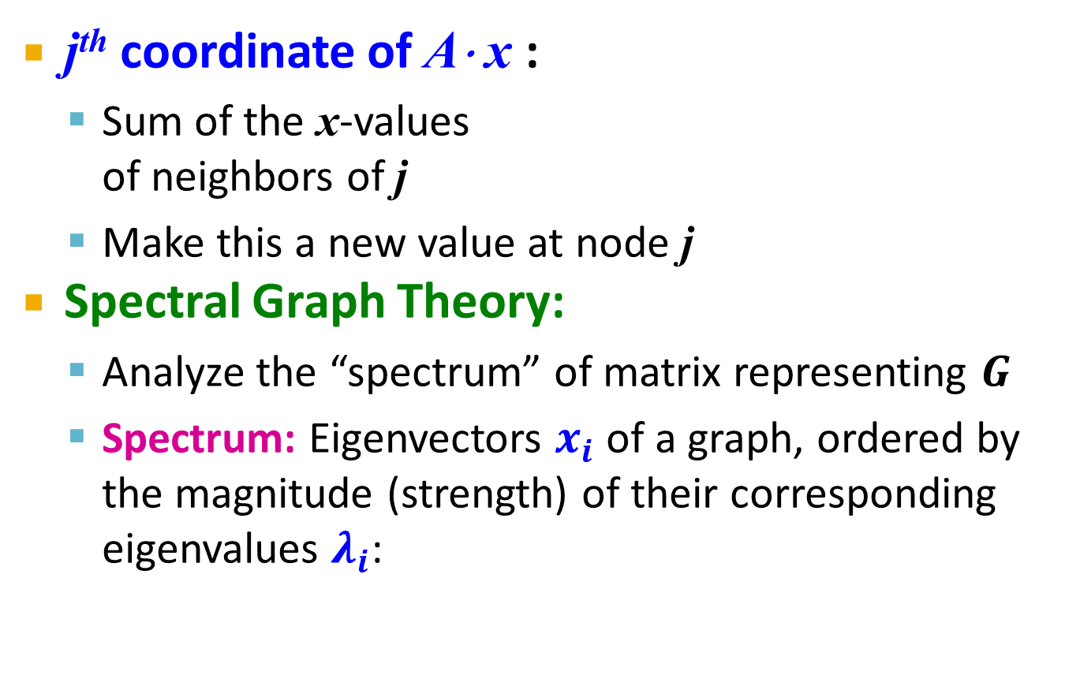
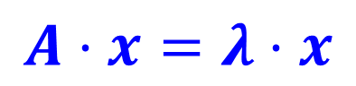
What is the meaning of Ax?
j^{th} coordinate of A⋅ x :
Sum of the x-values of neighbors of j
Make this a new value at node j
Spectral Graph Theory:
Analyze the “spectrum” of matrix representing $G$
Spectrum: Eigenvectors $x_{i}$ of a graph, ordered by the magnitude (strength) of their corresponding eigenvalues $λ_{i}$:
$$A⋅x=λ⋅x$$

Slide 32
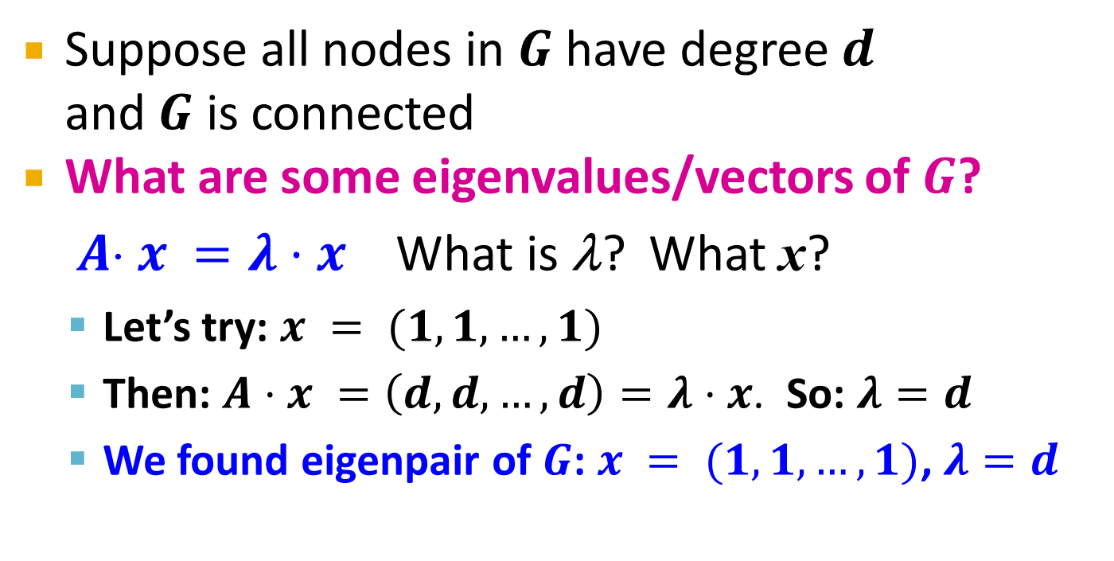
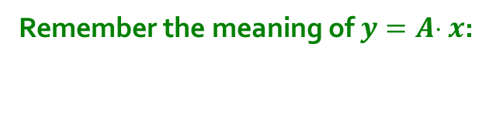
Example: d-regular graph
Suppose all nodes in $G$ have degree $d$ and $G$ is connected
What are some eigenvalues/vectors of $G$? $A x =λ⋅x$ What is λ? What x?
Let’s try: $x = (1,1,…,1)$
Then: $A⋅x =\left(d,d,…,d\right)=λ⋅x$. So: $λ=d$
We found eigenpair of $G$: $x = (1,1,…,1)$, $λ=d$
Remember the meaning of $y=A x$:

Slide 33
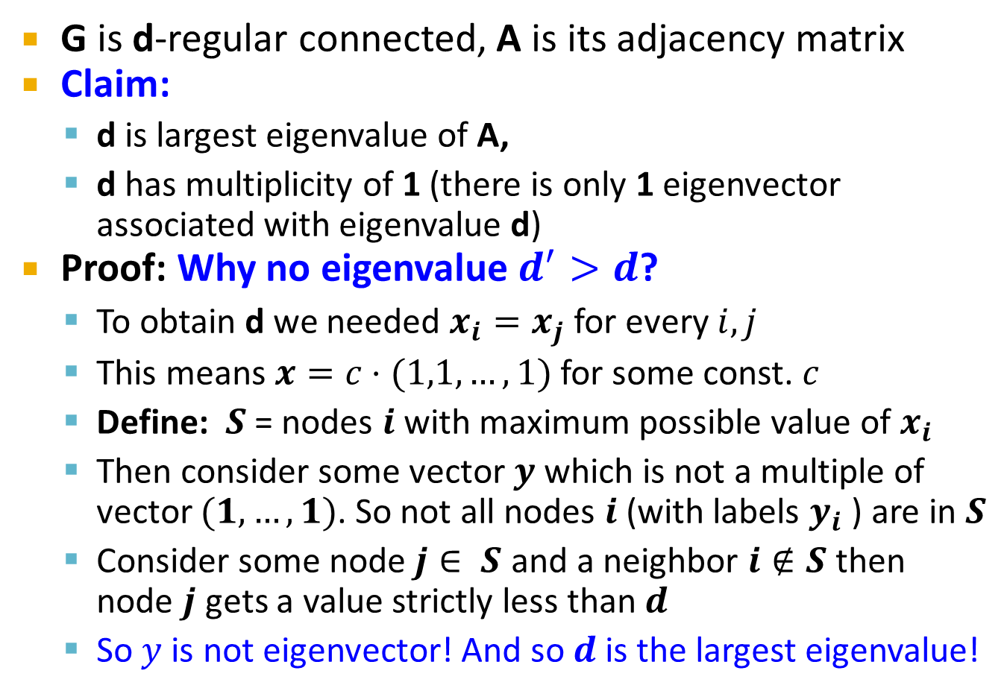
d is the largest eigenvalue of A
Details!
G is d-regular connected, A is its adjacency matrix
Claim:
d is largest eigenvalue of A,
d has multiplicity of 1 (there is only 1 eigenvector associated with eigenvalue d)
Proof: Why no eigenvalue $d^{′}>d$?
To obtain d we needed $x_{i}=x_{j}$ for every $i,j$
This means $x=c⋅(1,1,…,1)$ for some const. $c$
Define: $S$ = nodes $i$ with maximum possible value of $x_{i}$
Then consider some vector $y$ which is not a multiple of vector $(1,…,1)$. So not all nodes $i$ (with labels $y_{i}$ ) are in $S$
Consider some node$j∈ S$ and a neighbor $i∉S$ then node $j$ gets a value strictly less than $d$
So $y$is not eigenvector! And so $d$ is the largest eigenvalue!

Slide 34
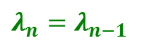

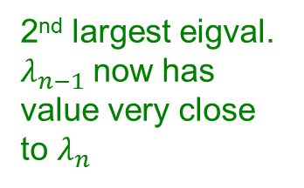
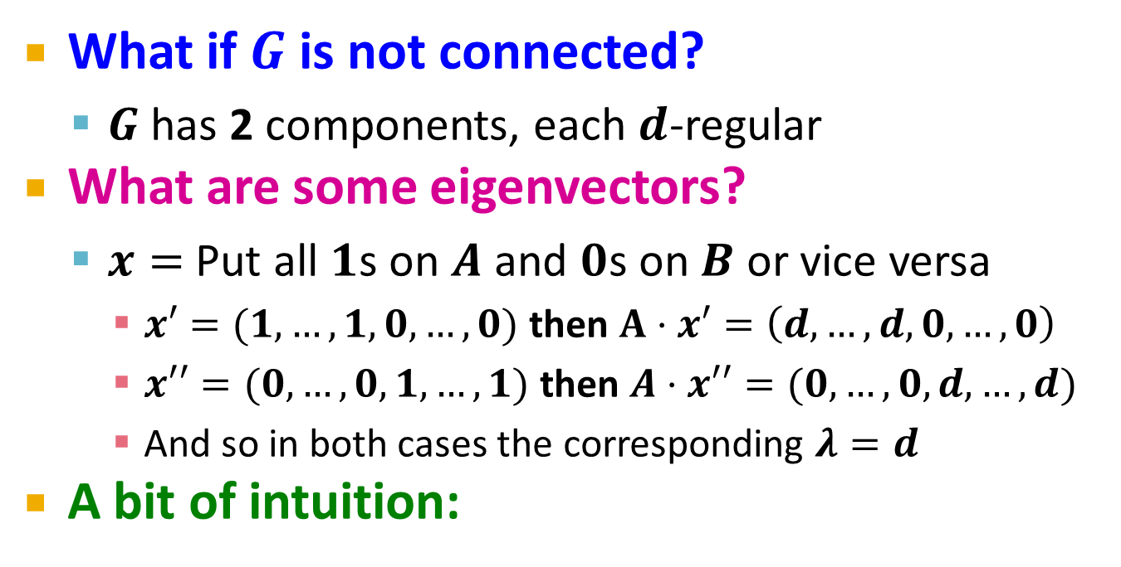
Example: Graph on 2 components
What if $G$ is not connected?
$G$ has 2 components, each $d$-regular
What are some eigenvectors?
$x=$ Put all $1$s on $A$ and $0$s on $B$ or vice versa
$x′=(1,…,1,0,…,0)$ then $A⋅x′=\left(d,…,d,0,…,0\right)$
$x′′=(0,…,0,1,…,1)$ then $A⋅x′′=(0,…,0,d,…,d)$
And so in both cases the corresponding $λ=d$
A bit of intuition:
A
B
|A|
|B|
A
2nd largest eigval. $λ_{n−1}$now has value very close to $λ_{n}$
B
A
B
$$λ_{n}=λ_{n−1}$$
$$λ_{n}−λ_{n−1}≈0$$

Slide 35
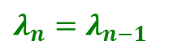


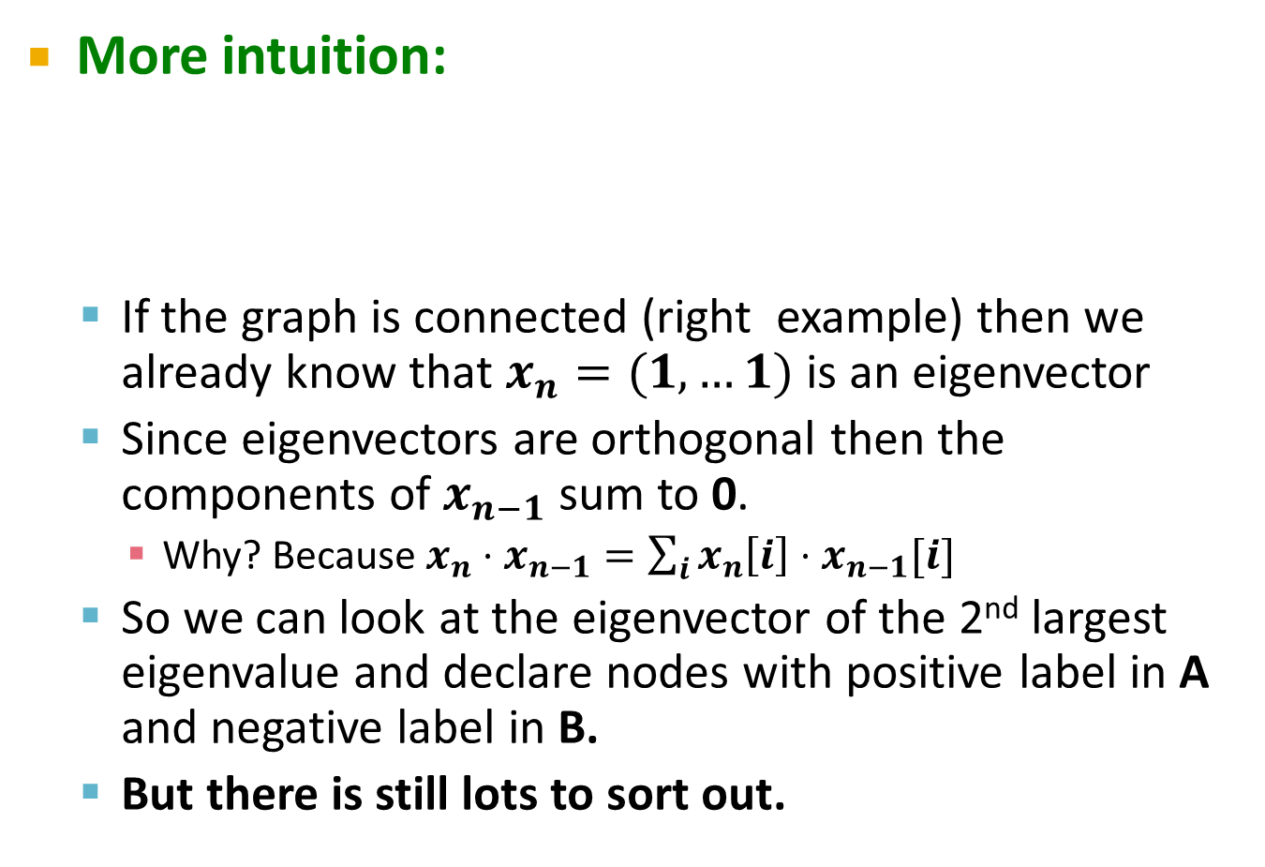
More Intuition
More intuition:
If the graph is connected (right example) then we already know that $x_{n}=(1,…1)$ is an eigenvector
Since eigenvectors are orthogonal then the components of $x_{n−1}$ sum to 0.
Why? Because $x_{n}⋅x_{n−1}=\sum_{i}{x_{n}\left[i\right]⋅x_{n−1}[i]}$
So we can look at the eigenvector of the 2nd largest eigenvalue and declare nodes with positive label in A and negative label in B.
But there is still lots to sort out.
A
2nd largest eigval. $λ_{n−1}$now has value very close to $λ_{n}$
B
A
B
$$λ_{n}=λ_{n−1}$$
$$λ_{n}−λ_{n−1}≈0$$

Slide 36
Matrix Representations
Adjacency matrix (A):
n× n matrix
A=[a_{ij}], a_{ij}=1 if edge between node i and j
Important properties:
Symmetric matrix
Eigenvectors are real and orthogonal
 | 1 | 2 | 3 | 4 | 5 | 6
1 | 0 | 1 | 1 | 0 | 1 | 0
2 | 1 | 0 | 1 | 0 | 0 | 0
3 | 1 | 1 | 0 | 1 | 0 | 0
4 | 0 | 0 | 1 | 0 | 1 | 1
5 | 1 | 0 | 0 | 1 | 0 | 1
6 | 0 | 0 | 0 | 1 | 1 | 0
5
1
2
6
4
3

Slide 37
Matrix Representations
Degree matrix (D):
n× n diagonal matrix
D=[d_{ii}], d_{ii} = degree of node i
 | 1 | 2 | 3 | 4 | 5 | 6
1 | 3 | 0 | 0 | 0 | 0 | 0
2 | 0 | 2 | 0 | 0 | 0 | 0
3 | 0 | 0 | 3 | 0 | 0 | 0
4 | 0 | 0 | 0 | 3 | 0 | 0
5 | 0 | 0 | 0 | 0 | 3 | 0
6 | 0 | 0 | 0 | 0 | 0 | 2
5
1
2
6
4
3

Slide 38
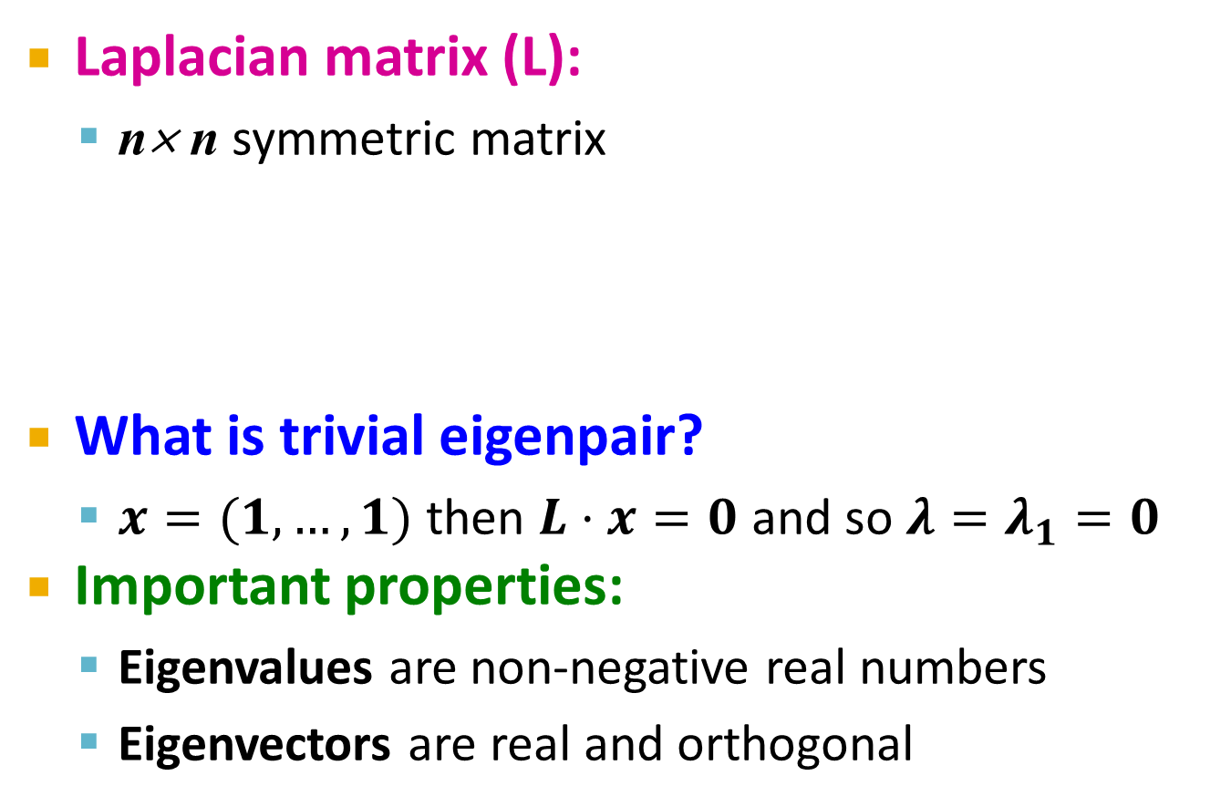
Matrix Representations
 | 1 | 2 | 3 | 4 | 5 | 6
1 | 3 | -1 | -1 | 0 | -1 | 0
2 | -1 | 2 | -1 | 0 | 0 | 0
3 | -1 | -1 | 3 | -1 | 0 | 0
4 | 0 | 0 | -1 | 3 | -1 | -1
5 | -1 | 0 | 0 | -1 | 3 | -1
6 | 0 | 0 | 0 | -1 | -1 | 2
Laplacian matrix (L):
n× n symmetric matrix
What is trivial eigenpair?
$x=(1,…,1)$ then $L⋅x=0$ and so ${λ=λ}_{1}=0$
Important properties:
Eigenvalues are non-negative real numbers
Eigenvectors are real and orthogonal
1
5
2
6
4
3
$$L = D − A$$

Slide 39
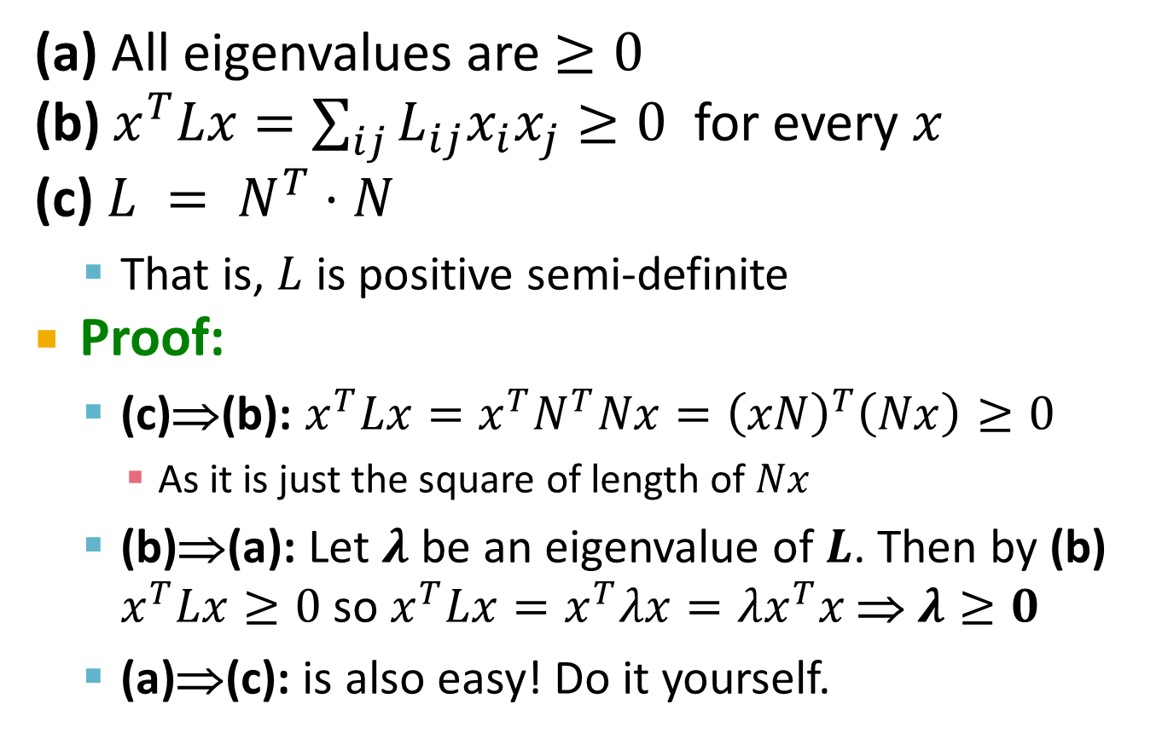
Facts about the Laplacian L
Details!
(a) All eigenvalues are $≥0$
(b) $x^{T}Lx=\sum_{ij}{L_{ij}x_{i}x_{j}}≥0$ for every $x$
(c) $L = N^{T}⋅N$
That is, $L$ is positive semi-definite
Proof:
(c)⇒(b): $x^{T}Lx=x^{T}N^{T}Nx={\left(xN\right)}^{T}\left(Nx\right)≥0$
As it is just the square of length of $Nx$
(b)⇒(a): Let $λ$ be an eigenvalue of $L$. Then by (b) $x^{T}Lx≥0$ so $x^{T}Lx=x^{T}λx=λx^{T}x$ ⇒ $λ≥0$
(a)⇒(c): is also easy! Do it yourself.

Slide 40
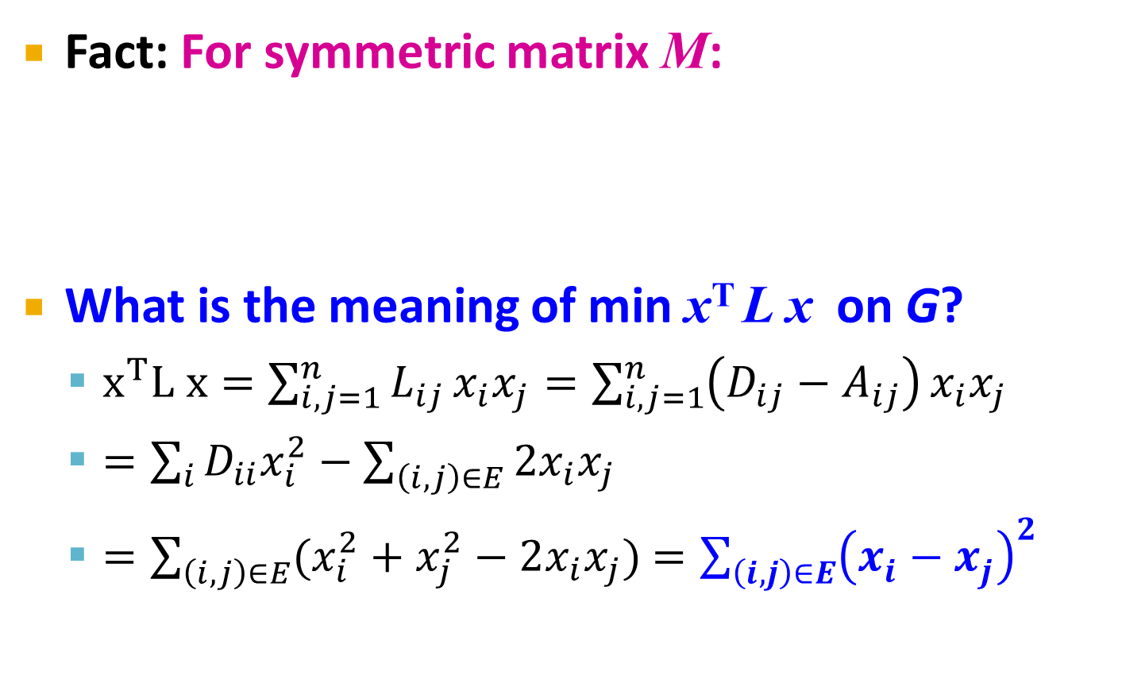
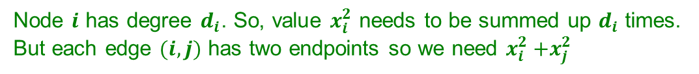
λ₂ as optimization problem
Fact: For symmetric matrix M:
What is the meaning of min x^{T} L x on G?
$x^{T}L x=\sum_{i,j=1}^{n}{L_{ij}}x_{i}x_{j}=\sum_{i,j=1}^{n}{\left(D_{ij}−A_{ij}\right)}x_{i}x_{j}$
$=\sum_{i}{D_{ii}x_{i}^{2}}−\sum_{\left(i,j\right)∈E}{2x_{i}x_{j}}$
$=\sum_{\left(i,j\right)∈E}{(x_{i}^{2}+x_{j}^{2}−2x_{i}x_{j})}$ $=\sum_{\left(i,j\right)∈E}{{\left(x_{i}^{}−x_{j}^{}\right)}^{2}}$
Node $i$ has degree $d_{i}$. So, value $x_{i}^{2}$ needs to be summed up $d_{i}$ times.
But each edge $(i,j)$ has two endpoints so we need $x_{i}^{2}{+x}_{j}^{2}$
Notes:
Sum_i Dii xi^2 = \sum_ij xi^2 + xj^2
Node i has degree Dii so for each edge I sum xi^2 once.
But edge has 2 endpoints so I have to take + xj^2

Slide 41
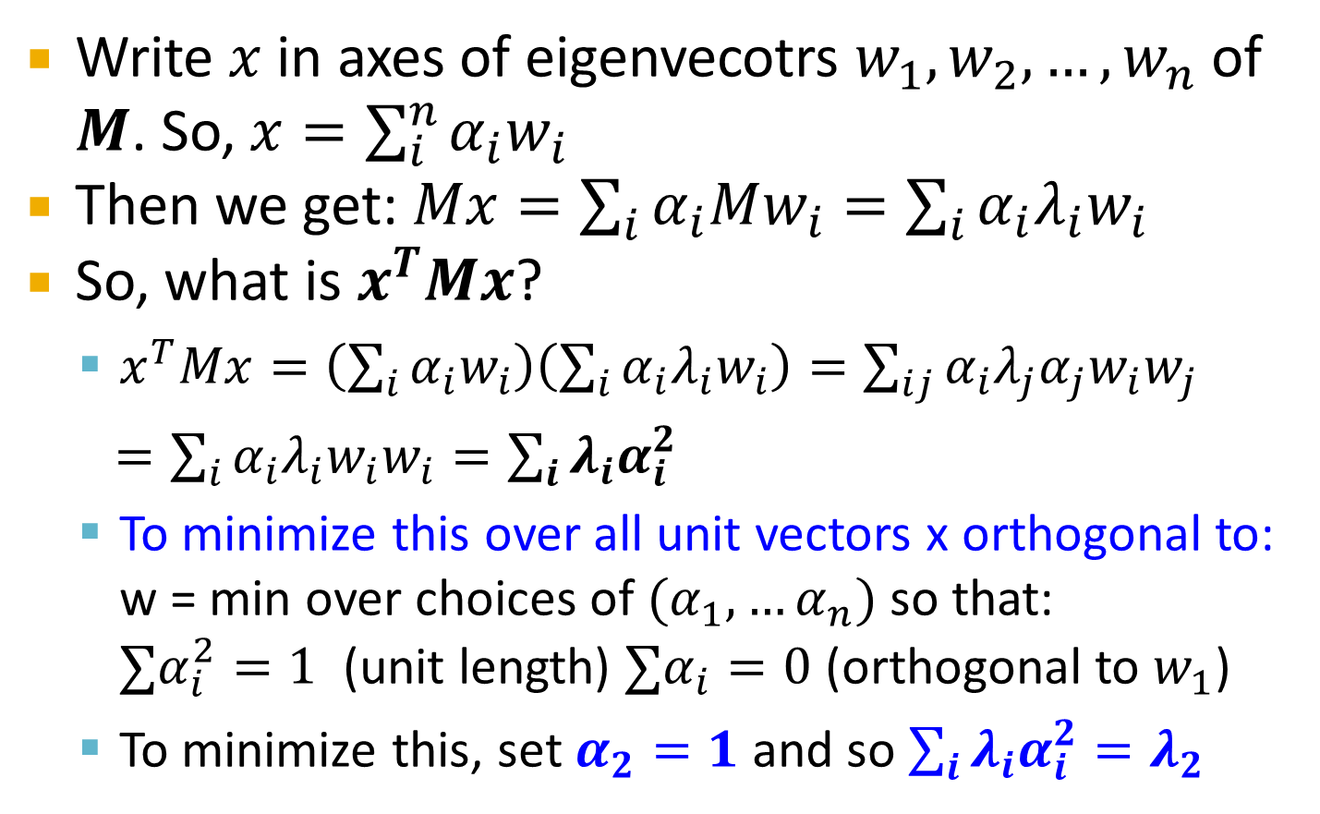


Proof:
Details!
Write $x$ in axes of eigenvecotrs $w_{1},w_{2}, …, w_{n}$ of $M$. So, $x=\sum_{i}^{n}{α_{i}w_{i}}$
Then we get: $Mx=\sum_{i}{α_{i}Mw_{i}}=\sum_{i}{α_{i}λ_{i}w_{i}}$
So, what is $x^{T}Mx$?
$x^{T}Mx=\left(\sum_{i}{α_{i}w_{i}}\right)\left(\sum_{i}{α_{i}λ_{i}w_{i}}\right)=\sum_{ij}{α_{i}λ_{j}α_{j}w_{i}w_{j}}$
$=\sum_{i}{α_{i}λ_{i}w_{i}w_{i}}=\sum_{i}{λ_{i}α_{i}^{2}}$
To minimize this over all unit vectors x orthogonal to: w = min over choices of $(α_{1}, …α_{n})$ so that: $∑α_{i}^{2}=1$ (unit length) $∑α_{i}=0$ (orthogonal to $w_{1}$)
To minimize this, set $α_{2}=1$ and so $\sum_{i}{λ_{i}α_{i}^{2}=λ_{2}}$
$$λ_{i}w_{i}$$
$=0$ if $i≠j$
1 otherwise

Slide 42





λ₂ as optimization problem
What else do we know about x?
$x$ is unit vector: $\sum_{i}{x_{i}^{2}=1}$
$x$ is orthogonal to 1st eigenvector $(1,…,1)$thus: $\sum_{i}{x_{i}⋅1}=\sum_{i}{x_{i}}=0$
Remember:
All labelings of nodes $i$ so that $∑x_{i}=0$
i
j
x
We want to assign values $x_{i}$ to nodes i such that few edges cross 0. (we want x_{i} and x_{j} to subtract each other)
$$x_{i}$$
0
$$x_{j}$$
Balance to minimize

Slide 43




Find Optimal Cut [Fiedler’73]
Back to finding the optimal cut
Express partition (A,B) as a vector
$$y_{i}=\left\{\begin{matrix}+1 \\ −1\end{matrix} \begin{matrix}if i∈A \\ if i∈B\end{matrix}\right.$$
We can minimize the cut of the partition by finding a non-trivial vector x that minimizes:
Can’t solve exactly. Let’s relax $y$ and allow it to take any real value.
$$y_{i}=−1$$
0
j
$$y_{j}=+1$$

Slide 44


Rayleigh Theorem
i
0
j
x
$$x_{i}$$
$$x_{j}$$
$\underset{y}{λ_{2}=min}{f\left(y\right)}$: The minimum value of $f(y)$ is given by the 2nd smallest eigenvalue λ₂ of the Laplacian matrix L
$x=arg{min_{y}{f\left(y\right)}}$: The optimal solution for y is given by the corresponding eigenvector $x$, referred as the Fiedler vector

Slide 45


Approx. Guarantee of Spectral
Details!
Suppose there is a partition of G into A and B where $\left|A\right|≤|B|$, s.t. $α=\frac{(\# edges from A to B)}{\left|A\right|}$ then $2α≥λ_{2}$
This is the approximation guarantee of the spectral clustering. It says the cut spectral finds is at most 2 away from the optimal one of score $α$.
Proof:
Let: a=|A|, b=|B| and e= # edges from A to B
Enough to choose some $x_{i}$ based on A and B such that: $λ_{2}≤\frac{∑{\left(x_{i}−x_{j}\right)}^{2}}{\sum_{i}{x_{i}^{2}}}≤2α$ (while also $\sum_{i}{x_{i}=0}$)
$λ_{2}$ is only smaller

Slide 46

Approx. Guarantee of Spectral
Details!
Proof (continued):
1) Let’s set: $x_{i}=\left\{\begin{matrix}−\frac{1}{a} \\ +\frac{1}{b}\end{matrix} \begin{matrix}if i∈A \\ if i∈B\end{matrix}\right.$
Let’s quickly verify that $\sum_{i}{x_{i}=0: a\left(−\frac{1}{a}\right)+b\left(\frac{1}{b}\right)=0}$
2) Then: $\frac{∑{\left(x_{i}−x_{j}\right)}^{2}}{\sum_{i}{x_{i}^{2}}}=\frac{\sum_{i∈A,j∈B}{{\left(\frac{1}{b}+\frac{1}{a}\right)}^{2}}}{a{\left(−\frac{1}{a}\right)}^{2}+b{\left(\frac{1}{b}\right)}^{2}}=\frac{e⋅{\left(\frac{1}{a}+\frac{1}{b}\right)}^{2}}{\frac{1}{a}+\frac{1}{b}}=e\left(\frac{1}{a}+\frac{1}{b}\right)≤e\left(\frac{1}{a}+\frac{1}{a}\right)≤e\frac{2}{a}=2α$
Which proves that the cost achieved by spectral is better than twice the OPT cost
e … number of edges between A and B

Slide 47

Approx. Guarantee of Spectral
Details!
Putting it all together:
$$2α≥λ_{2}≥\frac{α^{2}}{2k_{max}}$$
where $k_{max}$ is the maximum node degree in the graph
Note we only provide the 1st part: $2α≥λ_{2}$
We did not prove $λ_{2}≥\frac{α^{2}}{2k_{max}}$
Overall this always certifies that $λ_{2}$ always gives a useful bound

Slide 48
So far…
How to define a “good” partition of a graph?
Minimize a given graph cut criterion
How to efficiently identify such a partition?
Approximate using information provided by the eigenvalues and eigenvectors of a graph
Spectral Clustering

Slide 49
Spectral Clustering Algorithms
Three basic stages:
1) Pre-processing
Construct a matrix representation of the graph
2) Decomposition
Compute eigenvalues and eigenvectors of the matrix
Map each point to a lower-dimensional representation based on one or more eigenvectors
3) Grouping
Assign points to two or more clusters, based on the new representation

Slide 50
Spectral Partitioning Algorithm
1) Pre-processing:
Build Laplacian matrix L of the graph
2) Decomposition:
Find eigenvalues λ and eigenvectors x of the matrix L
Map vertices to corresponding components of λ₂
 | 1 | 2 | 3 | 4 | 5 | 6
1 | 3 | -1 | -1 | 0 | -1 | 0
2 | -1 | 2 | -1 | 0 | 0 | 0
3 | -1 | -1 | 3 | -1 | 0 | 0
4 | 0 | 0 | -1 | 3 | -1 | -1
5 | -1 | 0 | 0 | -1 | 3 | -1
6 | 0 | 0 | 0 | -1 | -1 | 2
0.0
0.4
0.3
-0.5
-0.2
-0.4
-0.5
1.0
0.4
0.6
0.4
-0.4
0.4
0.0
λ=
3.0
X =
0.4
0.3
0.1
0.6
-0.4
0.5
3.0
0.4
-0.3
0.1
0.6
0.4
-0.5
4.0
0.4
-0.3
-0.5
-0.2
0.4
0.5
5.0
0.4
-0.6
0.4
-0.4
-0.4
0.0
1
0.3
2
0.6
3
0.3
How do we now find the clusters?
4
-0.3
5
-0.3
6
-0.6

Slide 51
Spectral Partitioning
3) Grouping:
Sort components of reduced 1-dimensional vector
Identify clusters by splitting the sorted vector in two
How to choose a splitting point?
Naïve approaches:
Split at 0 or median value
More expensive approaches:
Attempt to minimize normalized cut in 1-dimension (sweep over ordering of nodes induced by the eigenvector)
1
0.3
Split at 0:
Cluster A: Positive points
Cluster B: Negative points
A
B
2
0.6
3
0.3
4
-0.3
1
0.3
4
-0.3
5
-0.3
2
0.6
5
-0.3
6
-0.6
3
0.3
6
-0.6

Slide 52


Example: Spectral Partitioning
Value of x₂
Rank in x₂

Slide 53


Example: Spectral Partitioning
Components of x₂
Value of x₂
Rank in x₂

Slide 54


Example: Spectral partitioning
Components of x₁
Components of x₃

Slide 55
k-Way Spectral Clustering
How do we partition a graph into k clusters?
Two basic approaches:
Recursive bi-partitioning [Hagen et al., ’92]
Recursively apply bi-partitioning algorithm in a hierarchical divisive manner
Disadvantages: Inefficient, unstable
Cluster multiple eigenvectors [Shi-Malik, ’00]
Build a reduced space from multiple eigenvectors
Commonly used in recent papers
A preferable approach…

Slide 56
Why use multiple eigenvectors?
Approximates the optimal cut [Shi-Malik, ’00]
Can be used to approximate optimal k-way normalized cut
Emphasizes cohesive clusters
Increases the unevenness in the distribution of the data
Associations between similar points are amplified, associations between dissimilar points are attenuated
The data begins to “approximate a clustering”
Well-separated space
Transforms data to a new “embedded space”, consisting of k orthogonal basis vectors
Multiple eigenvectors prevent instability due to information loss

Slide 57
Analysis of Large Graphs: Trawling

Slide 58
Trawling
[Kumar et al. ‘99]
Searching for small communities in the Web graph
What is the signature of a community / discussion in a Web graph?
Use this to define “topics”:
What the same people on the left talk about on the right
Remember HITS!
…
…
…
Dense 2-layer graph
Intuition: Many people all talking about the same things

Slide 59
Searching for Small Communities
A more well-defined problem: Enumerate complete bipartite subgraphs K_{s,t}
Where K_{s,t} : s nodes on the “left” where each links to the same t other nodes on the “right”
|X| = s = 3
|Y| = t = 4
X
Y
K_{3,4}
Fully connected

Slide 60
Frequent Itemset Enumeration
[Agrawal-Srikant ‘99]
Market basket analysis. Setting:
Market: Universe U of n items
Baskets: m subsets of U: S₁, S₂, …, S_{m} ⊆ U (S_{i} is a set of items one person bought)
Support: Frequency threshold f
Goal:
Find all subsets T s.t. T ⊆ S_{i} of at least f sets S_{i} (items in T were bought together at least f times)
What’s the connection between the itemsets and complete bipartite graphs?

Slide 61
From Itemsets to Bipartite K_{s,t}
[Kumar et al. ‘99]
Frequent itemsets = complete bipartite graphs!
How?
View each node i as a set S_{i} of nodes i points to
K_{s,t} = a set Y of size t that occurs in s sets S_{i}
Looking for K_{s,t} → set of frequency threshold to s and look at layer t – all frequent sets of size t
a
b
S_{i}={a,b,c,d}
i
c
d
a
j
b
i
c
k
d
X
Y
s … minimum support (|X|=s)
t … itemset size (|Y|=t)

Slide 62
From Itemsets to Bipartite K_{s,t}
[Kumar et al. ‘99]
View each node i as a set S_{i} of nodes i points to
Say we find a frequent itemset Y={a,b,c} of supp s So, there are s nodes that link to all of {a,b,c}:
a
b
i
c
a
a
d
b
a
S_{i}={a,b,c,d}
b
x
y
z
c
c
b
Find frequent itemsets:
s … minimum support
t … itemset size
c
We found K_{s,t}!
K_{s,t} = a set Y of size t that occurs in s sets S_{i}
a
x
b
y
c
z
Y
X

Slide 63
Example (1)
a
b
Support threshold s=2
{b,d}: support 3
{e,f}: support 2
And we just found 2 bipartite subgraphs:
c
d
e
f
Itemsets:
a = {b,c,d}
b = {d}
c = {b,d,e,f}
d = {e,f}
e = {b,d}
f = {}
a
b
c
d
c
d
e
f
e

Slide 64

Example (2)
Example of a community from a web graph
Nodes on the right
Nodes on the left
[Kumar, Raghavan, Rajagopalan, Tomkins: Trawling the Web for emerging cyber-communities 1999]

